Slide 1

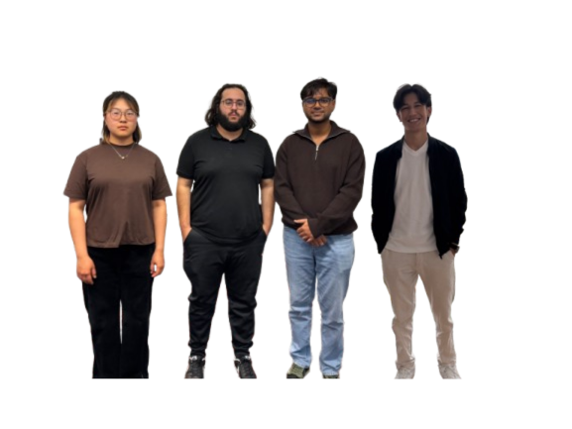







Welcome to team Khichuri’s presentation
Project 2 Conversion
Converting Project 1 to a Dynamic PHP/MySQL Site
Static Site
Dynamic Site
HTML/CSS
PHP/MySQL
Team Members:
Ali Jawid Behzad
Yitian Yuan
Yousaff Mohammad
Ayon Ahammed
October 27, 2025

Slide 2





Agenda
Context
Project 1 (Static) → Project 2 (PHP/MySQL with Includes + Database)
Team Roles
Ali, Yitian, Yousaff, Ayon
Live Demo Checkpoints
Demonstration of key conversion points
Q&A
Questions and discussion
Speaker Notes (0:15-0:45): Welcome everyone to our presentation on "From Static to Dynamic: Project 2 Conversion." Today, we'll walk you through our journey. We'll start by outlining the project context, introducing our team and their specific contributions. We'll then highlight key live demo checkpoints to showcase our work in action, and finally, open the floor for your questions.
From Static to Dynamic: Project 2 Conversion
2/16

Slide 3











Ali Jawid Behzad: Project 1 Contributions
Information architecture & semantics
Structured the About page with meaningful landmarks (<header>, <nav>, <main>, <footer>) and semantic blocks (<section>, <article>).Used <dl>/<dt>/<dd> for contributor bios; <figure>/<figcaption> for media; <table> with <caption>, <thead>, <tbody>, and scope for tabular “Fun Facts”.
About Page Lead
ID: 106188559
Accessibility Features
Accessibility (WCAG 2.1 AA intent)Added a visible skip link to jump to #main-content; preserved logical heading order (H1→H2→H3).Ensured label–control associations, ARIA attributes where needed (e.g., aria-labelledby), and keyboard-only focusability.Verified color contrast for text on dark headers/footers; provided descriptive alt text and title where appropriate.
Role: Project 1 About page development
Design Consistency
Optimized images dimensions and compression) for hero and team photos; enabled loading="lazy" where applicable.
Minimized render-blocking by keeping CSS consolidated and avoiding inline style bloat.

Slide 4






Ali Jawid Behzad: Project 2 Contributions
Task 1: UI Modularity
Centralized shared UI into header.inc, nav.inc, footer.inc
Converted all pages to .php with includes; fixed relative paths
Eliminated duplicated markup for easier maintenance
Task 2: Database Configuration
Implemented settings.php for XAMPP (localhost, root, no password)
Created a connection diagnostic tool for troubleshooting
Documented setup process and common failure modes
Task 7: Dynamic About Page
Designed about table with Project 1+2 contributions, also added favorite language and fun facts table
Refactored about.php to render dynamic <dl>/<dt>/<dd> from MySQL
Preserved original CSS while moving to database-driven content
Design consistency
Looking back at our headers, footers and navigation, had a lot of inconsistencies and were all one way or another different from each other thus I replaced all of them with consistent design, color and functionality making it easy to edit in the future and also looking professional
From Static to Dynamic: Project 2 Conversion
4/16

Slide 5






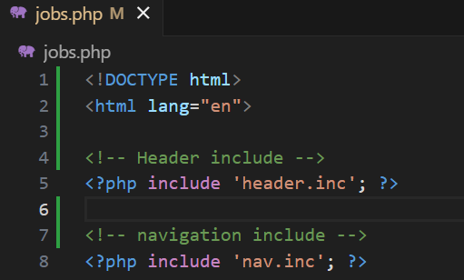





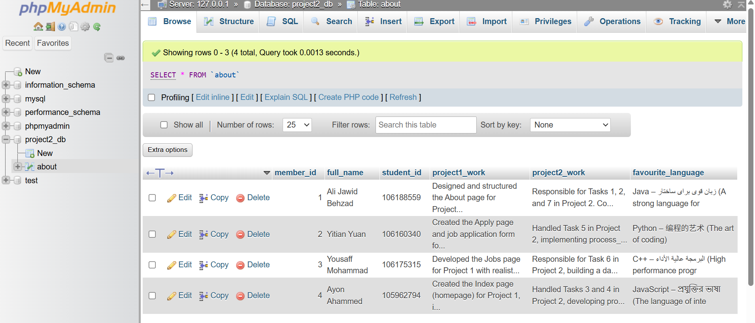
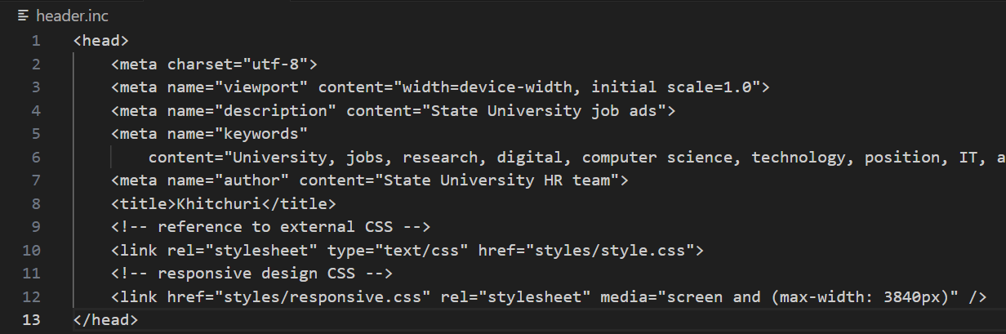
Ali Jawid Behzad: Evidence & Lessons
Evidence
Lessons Learned
PHP Includes Implementation example
Modularity Benefits
Enhanced code reusability and simplified maintenance through PHP includes
<?php include 'header.inc'; ?> <?php include 'nav.inc'; ?> <?php include 'footer.inc'; ?>
Single Source of Truth
Centralized layout and content management for consistent website appearance
DB-Driven Content
Enabled dynamic updates and easier content management without code changes
About table database
From Static to Dynamic: Project 2 Conversion
5/16

Slide 6
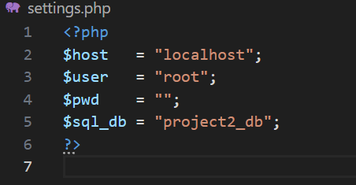
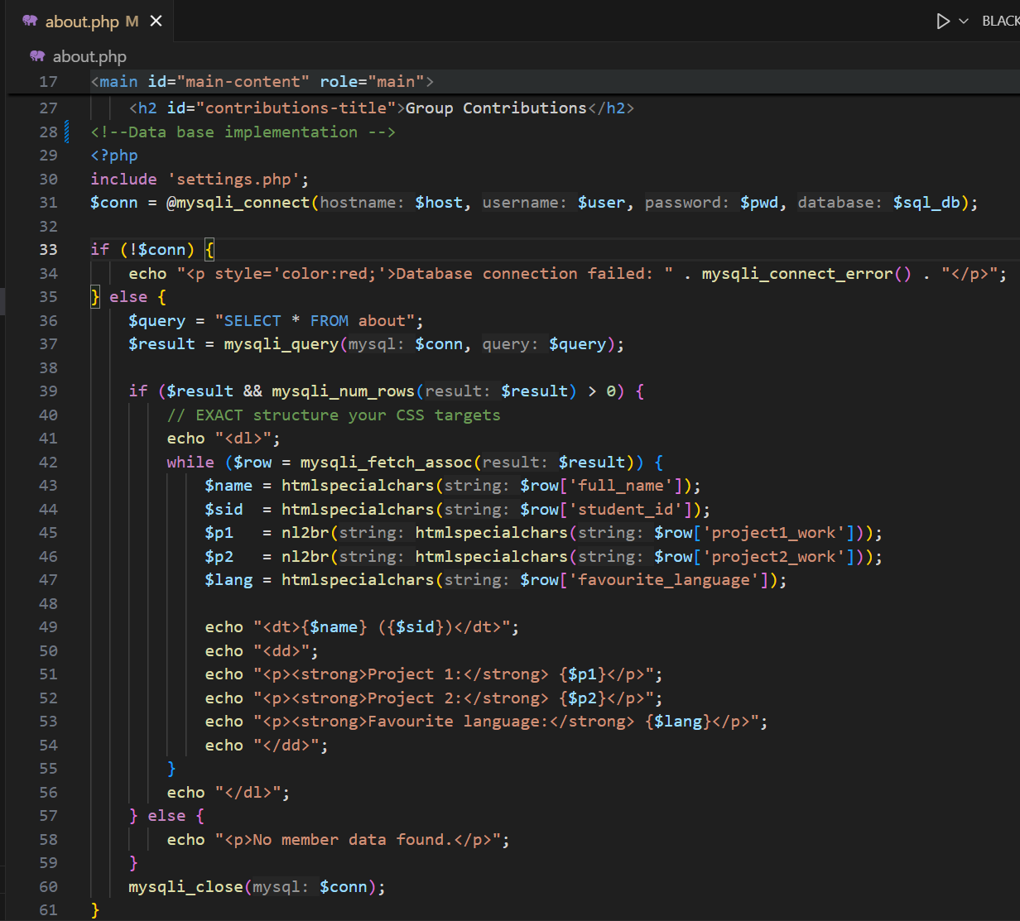
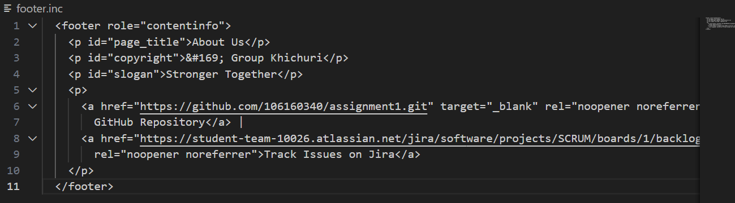
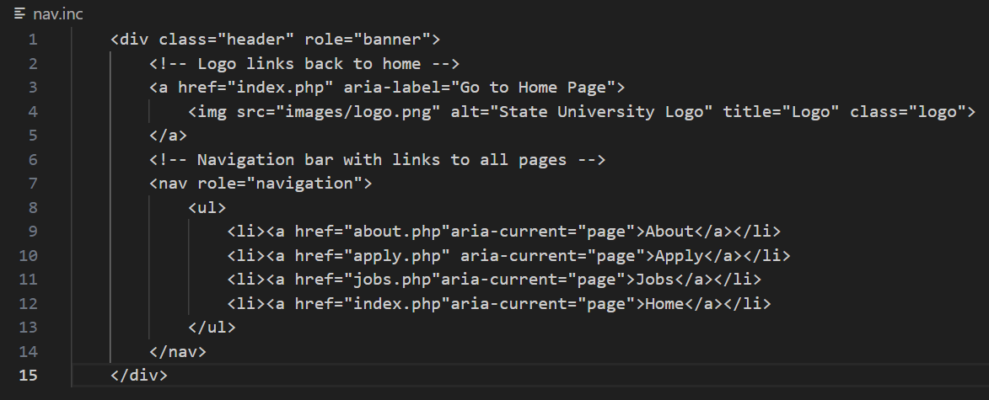
Ali Jawid Behzad: Evidence & Lessons
Settings
Evidence
About page
Footer include
Navigation include
From Static to Dynamic: Project 2 Conversion
5/16

Slide 7











Yitian Yuan: Project 1 & 2 Contributions
Project 1
Project 2
Apply Page Lead
Task 5: Server-side Processing
Built the Apply page with proper form structure and validation.
Implemented process_eoi.php with robust server-side validation.
Form Accessibility
Database Integration
Implemented proper labels and fieldsets for improved accessibility.
Created eoi table if missing; inserted validated records.
Input Sanitizing
Input Constraints
Normalized input with trim/escape/type checks; enforced POST-only.
Added appropriate input constraints and validation patterns.
ID: 106160340
Validation Policy
Added clear error messages; returned auto-generated EOI numbers.
From Static to Dynamic: Project 2 Conversion
6/16

Slide 8






















Yitian Yuan: Evidence & Lessons
Evidence
Lessons Learned
Form Submission Process
Server-Side Validation
Data Integrity: Server-side validation ensures only clean, valid data enters the database
apply.php
process_eoi.php
eoi table
Security: Protects against malicious input that could bypass client-side validation
Form with Validation Errors:
Robustness: Provides reliable data handling regardless of client implementation
First Name
[Empty input]
First name is required
User corrects errors and resubmits
Key Implementation Details
Table Creation: Script creates eoi table if it doesn't exist
Database Verification
Security Measure: Blocks direct GET access to process_eoi.php
Successful submission returns EOI number
Speaker Notes (1:30-2:00): For the evidence, we can see how the form submission process works with server-side validation. When a user submits the form, it goes to process_eoi.php which validates the data. If there are errors, they're displayed back to the user. Upon successful validation, the data is inserted into the database and an EOI number is returned. This demonstrates the complete flow from form submission to database storage. The key lesson here is that server-side validation is crucial for data integrity and security. While client-side validation provides immediate feedback to users, it can be easily bypassed. Server-side validation acts as a critical safeguard against malicious input and ensures that only clean, valid data enters the database.
EOI123456789
From Static to Dynamic: Project 2 Conversion
7/16

Slide 9




Yousaff Mohammad: Project 1 & 2 Contributions
Project 1 (Jobs Page Lead) - ID: 106175315
Project 2 (Dynamic Conversion)
Task 6: Created jobs table mirroring Project 1 fields
Authored the Jobs page with structured roles and requirements
Refactored jobs.php to render dynamically using SELECT + loop
Designed readable sections to improve user experience
Preserved original layout while implementing database-driven content
Created well-organized content layout for job listings
Implemented consistent formatting across job descriptions
Maintained single source of truth in DB for improved maintainability
Ensured clean separation of data and presentation
From Static to Dynamic: Project 2 Conversion
8/16

Slide 10













Yousaff Mohammad: Evidence & Lessons
Evidence
Lessons Learned
Database Table
Content Single-Sourcing
jobs table in phpMyAdmin
By storing job details in a MySQL database, we established a single, authoritative source for all job-related content.
job_id
title
description
1
Web Developer
Developing websites...
Separation of Concerns
2
Designer
Creating designs...
We decoupled content from presentation, allowing for easier updates and consistent display across the site.
Dynamic Rendering
Maintenance Benefits
This approach enhances maintainability and scalability, making future content management much more efficient.
<?php
$result = mysqli_query($conn, "SELECT * FROM jobs");
while($row = mysqli_fetch_assoc($result)) {
echo "<h3>" . $row['title'] . "</h3>";
Speaker Notes (1:30-2:00): For the Jobs page, I designed a database table that matched the structure of the original static content. This allowed me to create a dynamic page that retrieves and displays job listings from the database while maintaining the original visual design. The key lesson here is that by using a database-driven approach, we've established a single source of truth for our job listings, which makes updates much easier and ensures consistency across the site.
echo "<p>" . $row['description'] . "</p>";
}
?>
jobs.php dynamically renders job listings from the database
From Static to Dynamic: Project 2 Conversion
9/16

Slide 11






Ayon Ahammed: Project 1 & 2 Contributions
Project 1 (Index Page Lead) - ID: 105962794
Project 2 (Backend Integration)
Task 3: Ensured Apply form correctly posts to process_eoi.php
Built the Index (home) page with structured layout
Created hero image section for visual appeal
Task 3: Coordinated system flow from form to database insert
Developed overview content and initial navigation
Task 4: Implemented server-side validation approach
Implemented responsive design for multi-device support
Task 4: Verified EOI table creation with proper defaults
Mapped end-to-end user journey and verified links after refactor
From Static to Dynamic: Project 2 Conversion
10/16

Slide 12












Ayon Ahammed: Evidence & Lessons
Evidence
Lessons Learned
POST Request Flow
UX & Backend Consistency
Ensuring consistency between user experience and backend validation is paramount for a seamless application flow.
apply.php
process_eoi.php
Database
Validation Balance
Client-side validation offers immediate feedback, while server-side validation provides robust security and data integrity.
Database Record
Secure Data Flow
eoi table in phpMyAdmin
Proper form processing ensures data integrity and security throughout the application lifecycle.
id
status
123
New
Speaker Notes (1:45-2:15): For the evidence, I want to show how we implemented the POST request flow from the apply form to process_eoi.php and then to the database. You can see in the diagram that the data flows from the apply form, through process_eoi.php, and finally into the database. The screenshot shows that the record is inserted with status='New' as designed. For the lessons learned, the key takeaway is ensuring consistency between UX and backend validation. While client-side validation provides immediate feedback to users, server-side validation is crucial for security and data integrity. This dual approach creates a seamless and secure user journey.
Record shows status='New' as default
From Static to Dynamic: Project 2 Conversion
11/16

Slide 13
















Live Demo Flow
Live Demo
Database
PHP
1. Dynamic About Page
2. Form Submission
3. Dynamic Jobs Page
Shows database-driven contributions
EOI number generation
Real-time updates
Server-side validation
Database changes
DB-driven content
Database insertion
Live updates
Project contributions
Demo Sequence:
About → Shows database-driven contributions
Apply → Submit test form; process_eoi.php returns EOI number
Jobs → Edit a row in phpMyAdmin; refresh page to show dynamic change
Speaker Notes: Let's walk through our live demo. First, we'll look at the About page, which now pulls content from our database. Next, we'll submit a test form to demonstrate the server-side validation and EOI number generation. Finally, we'll edit a job listing in phpMyAdmin and show how the changes immediately reflect on the live Jobs page.
From Static to Dynamic: Project 2 Conversion
13/16

Slide 14









Conclusion & Next Steps
What We Learned
Next Steps
Modularity
Manage.php Queries
PHP includes streamline UI management and promote code reusability
Develop administrative interfaces for content management
Authentication Hardening
Database Integration
Implement robust user authentication and authorization
MySQL enables dynamic content and efficient data management
Deployment Checklist
Prepare for production deployment with a comprehensive checklist
Validation
Server-side validation is crucial for data integrity and security
Speaker Notes (2:15-2:30): This project successfully transformed a static website into a dynamic, database-driven application using PHP and MySQL. The experience provided valuable insights into modern web development practices.
Looking ahead, we have several key steps to continue our development. First, we'll develop administrative interfaces for content management through PHP queries. Second, we need to implement robust user authentication and authorization to enhance security. Finally, we'll prepare a comprehensive deployment checklist to ensure smooth production deployment.
From Static to Dynamic: Project 2 Conversion
15/16

Slide 15





Questions?
?
Thank You for Your Attention
We welcome your questions about any aspect of our Project 2 Conversion
PHP/MySQL Implementation
Team Contributions
Live Demo
Speaker Notes: Thank you for your attention. We've covered the conversion of our static website to a dynamic PHP/MySQL site, including the contributions from each team member. We're now open to questions about any aspect of our project conversion process.
From Static to Dynamic: Project 2 Conversion
16/16

